Slide 1


CAPSTONE PROJECT
Airbnb App User Churn Comprehensive Analysis
Project Workflow
Data Wrangling & Feature Selection
Random Forest Forecasting - Customer Conversion Analysis
Logistic Regression - Customer Churn Prediction Analysis
RFM Modeling (K-Means) - Customer Value Analysis

Slide 2

Airbnb App
User Data
Airbnb Open Data –App Users data within one week in the year 2019
Background/EDA
Data Pre-Processing
Feature Engineering & Selection
Package Used
Customer
Conversion
Python
Pandas
Numpy
Matplotlib
Seaborn
Sklearn
Customer Churn
Customer Value
Segmentation

Slide 3
Contents
Part1 - Data Wrangling & Feature Selection
Part2 - Customer Conversion Analysis - Random Forest Forecasting
Part3 - Customer Churn Prediction Analysis - Logistic Regression
Part4 - Customer Value Analysis - RFM Modeling (K-Means)

Slide 4
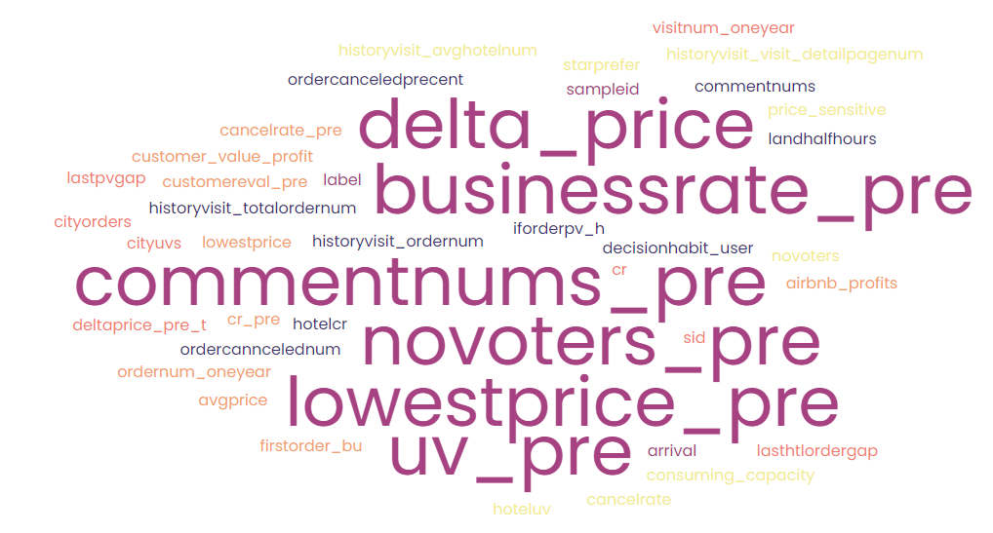
Background
EDA Overview
The data is produced from Airbnb App, exploring customer behavioral pattern (such as visit time, arrival time, order number, conversion rate, consuming capacity, averaging price, etc.)
Through data desensitization of user data
Label variable: 0 represents churn while 1 represents retention
70K Observations
50 Features
Lots of Missing Values
data sets with high kurtosis/skewness
No duplicates
Objective
To conduct Customer Churn Predictive Analysis based on binary label, “churn”.
To predict Customer Conversion using Random Forest Regression
To explore Customer Value from RFM Segmentation technique

Slide 5
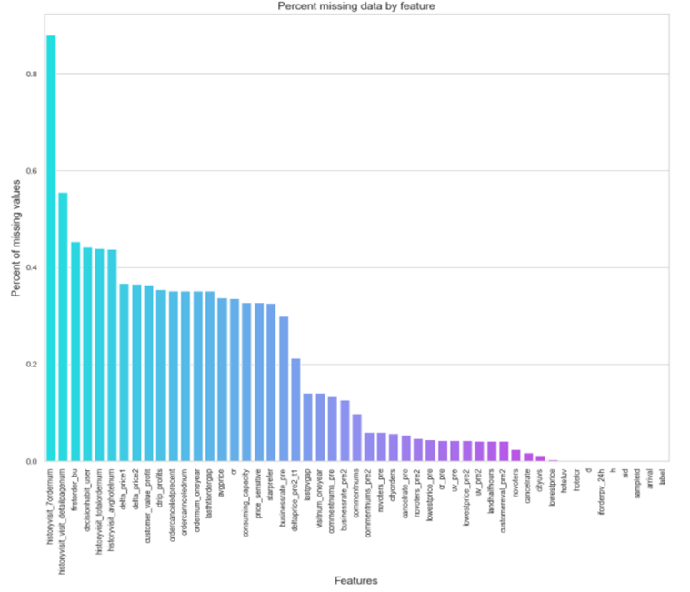
Data Pre-Processing
Missing Values
Imputation Rule
Fill in Median value for features having negative values
Fill in Mode value for categorical features
Fill in Mean value for the rest of features
Remove features with over 70% missing values
Outliers
Capping of outliers using
Percentile method
Any data points less than the value at first percentile or greater than value at 99th percentile could be possible outliers
Outlier detection and removal using percentile

Slide 6
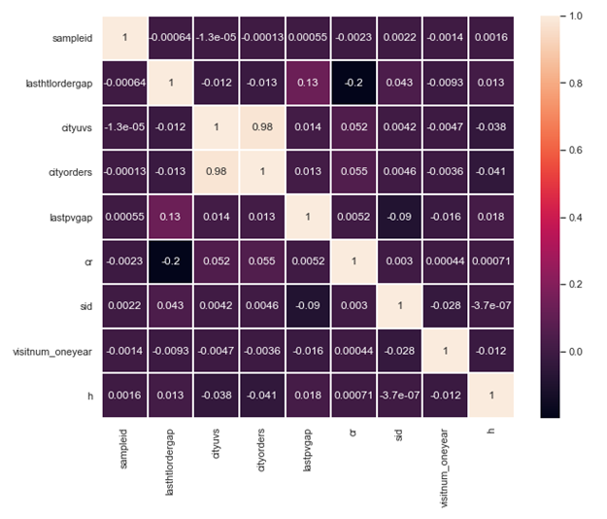
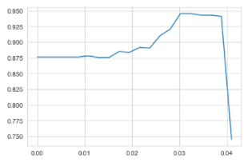
Feature Selection
Multiple Feature Selection Methods
Variance Threshold
Feature selector that removes all low-variance features
F-Test
Remove 7 Variables with 0 coefficient
Embedded Methods
Based on Random Forest Learning Curve, when the threshold equals to .03, the model wins the highest score – .94
Use the .03 threshold to get 8 features with importance over the threshold:
'lasthtlordergap', 'cityorders', ‘cityorders’, 'lastpvgap', 'cr', 'sid','visitnum_oneyear', 'h'
Filter out highly correlated features
It's been identified that there's a high correlation between ‘cityorders’ and ‘cityuvs’.
0.94

Slide 7
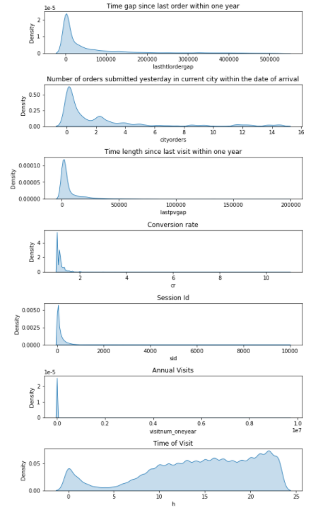
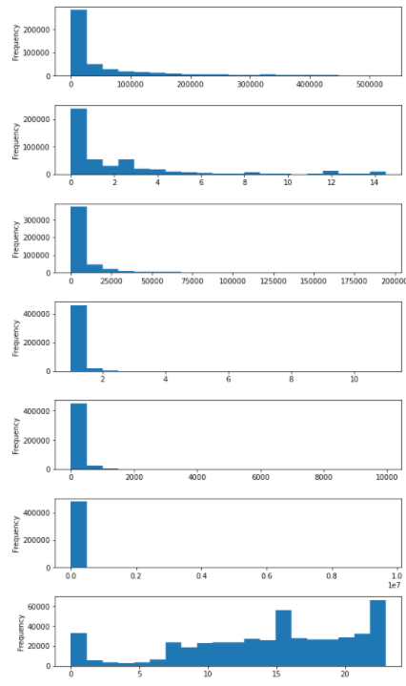
Feature Engineering
Statistical Data Feature Binning
Selection of Binning Methods
Data Distribution
Equal Width Binning
Data Distribution
Except for ‘h’, time of visit, all features data are skewed to right
Binning
Binning is used for the transformation of a continuous or numerical variable into a categorical feature
Binning of continuous variable introduces non-linearity and tends to improve the performance of the model
It can be also used to identify missing values or outliers
Unsupervised Binning
Unsupervised binning transforms variables into categorical bins without considering the target class label into account
For this project data, it adds limited information as highly skewed data distribution.
Alternatively, the entropy-based Supervised Binning was adopted for bucketing variables.

Slide 8
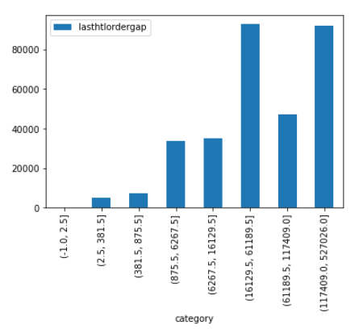
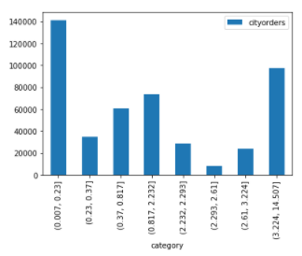
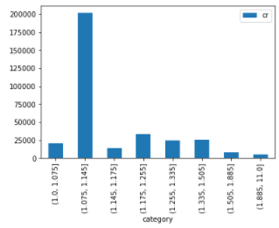
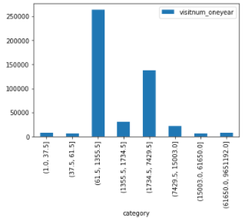
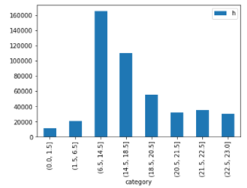
Binning based on CART Tree Impurity Thresholds
Optimal Binning / Supervised discretization
The algorithm is CART Tree which initially excludes missing values to compute the cut points –
y is a binary response variable,1 means churn, 0 means retention
lasthtlordergap
cityorders
cr
Time gap since last order
within one year
Number of orders submitted yesterday in current city within the date of arrival
Conversion Rate
General Steps
Use GridSearchCV to adjust parameters and get best leaf's sample percentage
Use best parameters to build CART tree model
Extract threshold of test node to calculate best cut points/bins
visitnum_oneyear
h
Annual Visit Number
Time of Visit

Slide 9
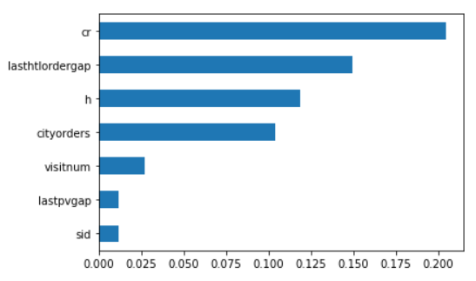
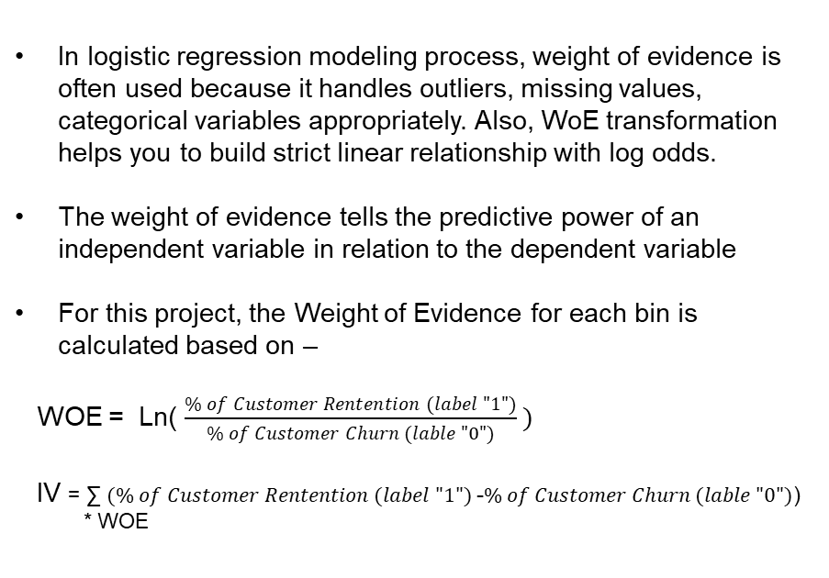
Feature Engineering
Statistical Data Feature Binning
Weight of Evidence Binning Information Value
In logistic regression modeling process, weight of evidence is often used because it handles outliers, missing values, categorical variables appropriately. Also, WoE transformation helps you to build strict linear relationship with log odds.
The weight of evidence tells the predictive power of an independent variable in relation to the dependent variable
For this project, the Weight of Evidence for each bin is calculated based on –
WOE = Ln( $\frac{\% of Customer Rentention (label "1")}{\% of Customer Churn (lable "0")} )$
IV = ∑ $(\% of Customer Rentention (label "1")$-$\% of Customer Churn (lable "0")$)
* WOE
Information value helps to rank/screen variables on the basis of their importance
variables with least IV value, ‘lastpvgap’ and ‘sid’, are eliminated

Slide 10
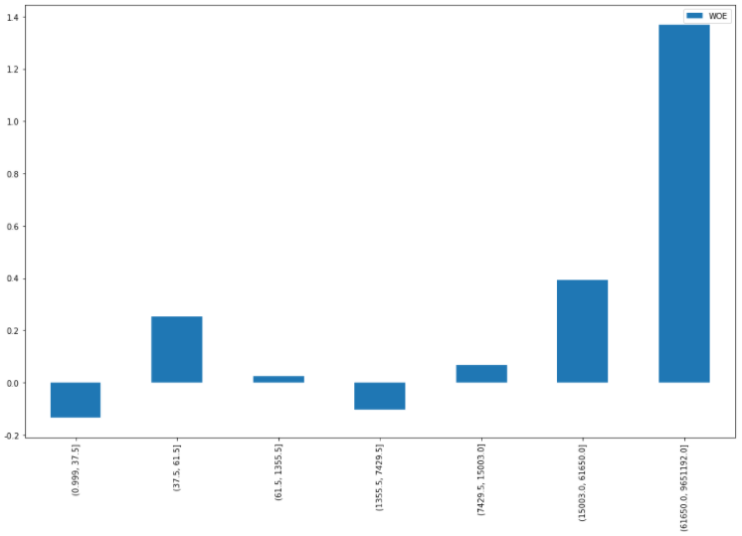
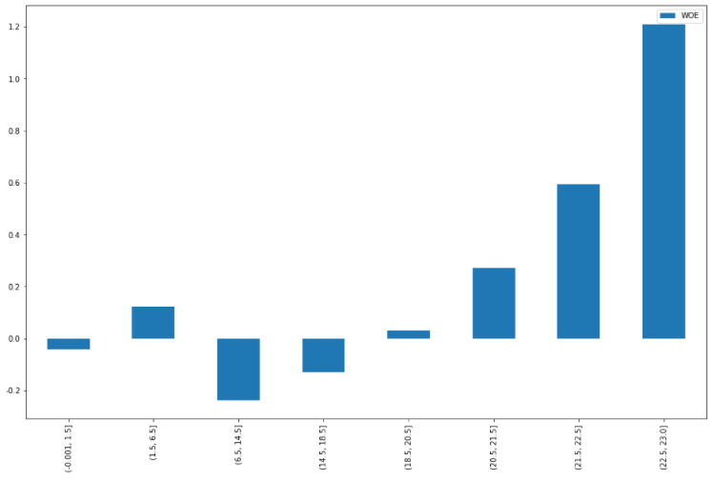
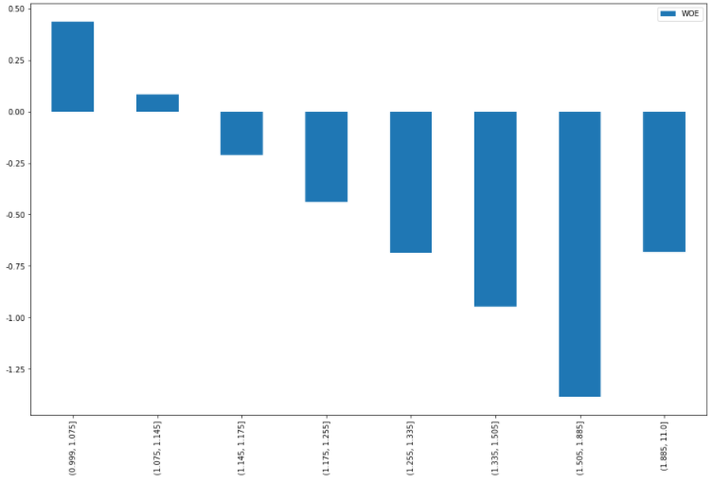
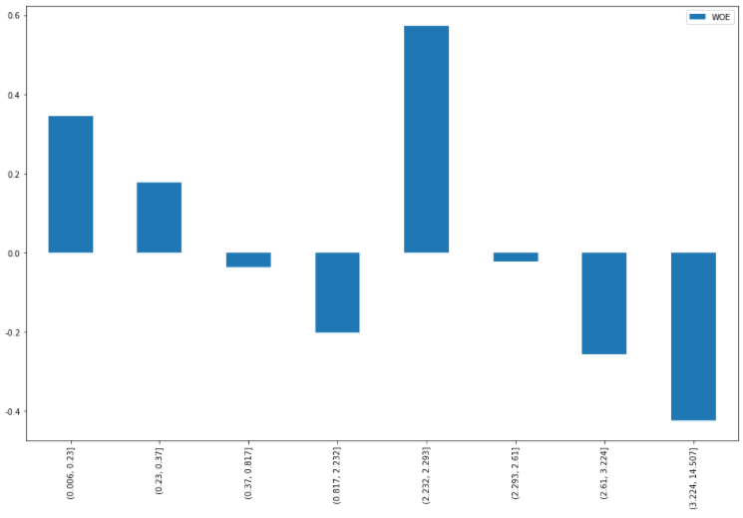
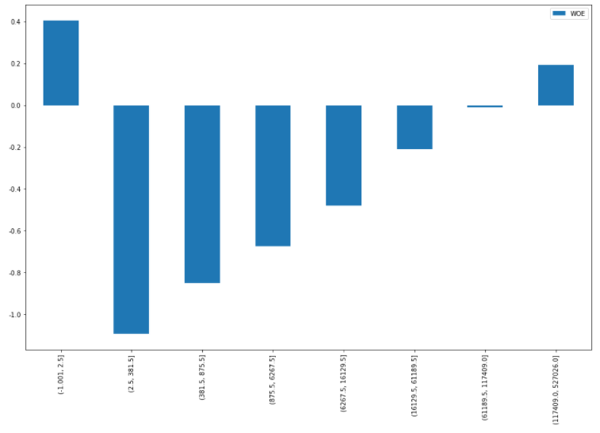
Feature Engineering
Weight of Evidence Binning
visitnum_oneyear
h
cr
cityorders
lasthtlordergap
The retention fluctuates slightly with low number of visits within one year
Only when the number of visits reaches a certain level (more than 15,000), the app gains significant customer retention and peaks after 61,650
The app has no good retention until 6:30 PM
In the evening, the customer retention ramps up and peaks between 10:30 PM and 11 PM.
When conversion rate is less than 1.14%, users retain relatively more users.
As conversion rate increases, churn rate also increases, but it should be noted that when conversion rate is over 1.89%, customer churn slowed down.
For cityorders in the 5th box (2.23, 2.293) interval, the app has best retention.
Except for box 5, the results of customer retention gradually decrease as the number of orders submitted yesterday increases.
For the lasthtlordergap interval of (2.5, 381.5), the app has most severe churn.
As time goes by, the risk of churn decreases.

Slide 11

Key Takeaways
for Churned User Pattern Personas
The number of annual visit less than 15,000 clicks
With order numbers larger than 2.61
With larger consumption
Visit the app in the morning
Shorter gap between visit time and arrival time
With conversion rate between
1.505 and 1.885

Slide 12
Contents
Part1 - Data Wrangling & Feature Selection
Part2 – Logistic Regression - Customer Churn Prediction Analysis
Part3 - Random Forest Forecasting - Customer Conversion Analysis
Part4 - RFM Modeling (K-Means) - Customer Value Analysis

Slide 13
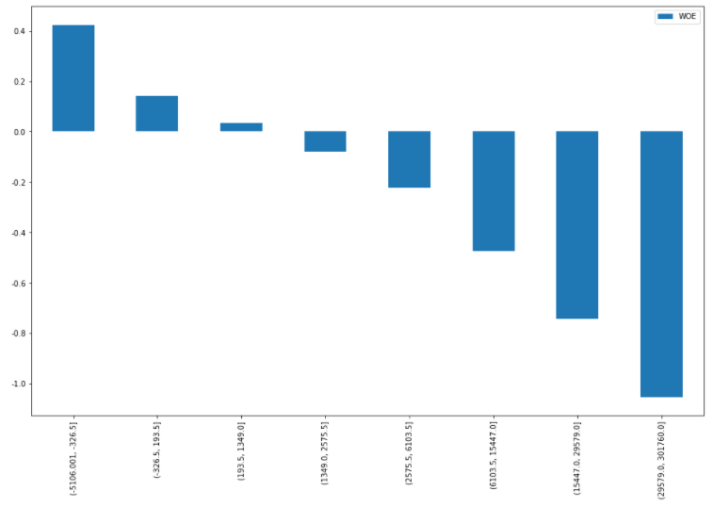
Logistic Regression
Creation of New Feature
Monetization of Order Consumption
Creation of new feature, ‘M’, Consumption monetary value
M = ordernum_oneyear * avgprice.
The ‘M’ has relatively higher IV. (0.12)
We multiply the average price and the annual order volume to get the annual consumption, find out that the more customers consume each year, the more churn exists.
The overall trend is diminishing. The more customers spend each year, the greater the risk of attrition.

Slide 14
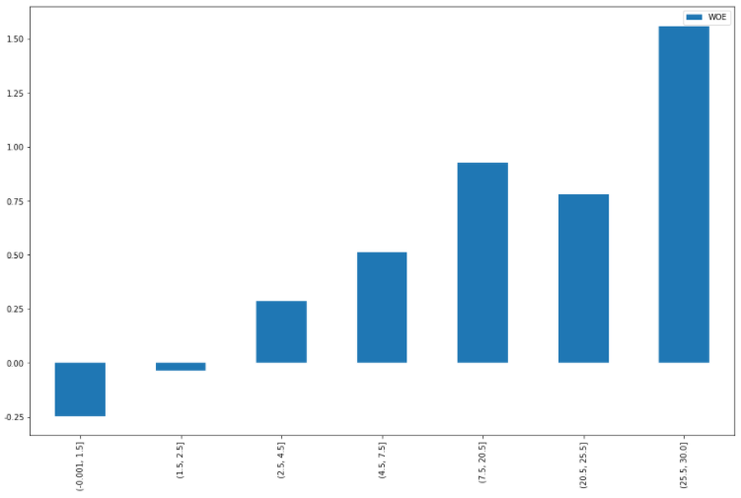
Logistic Regression
Creation of New Feature
Delta – Time Difference
Creation of new feature, ‘Delta’, time difference between app visit date and arrival date
Delta = arrival time – visit time.
The ‘Delta’ has relatively higher IV. (0.17)
From the perspective of bins, the longer the gap between visit date and arrival date, the less the churn is

Slide 15
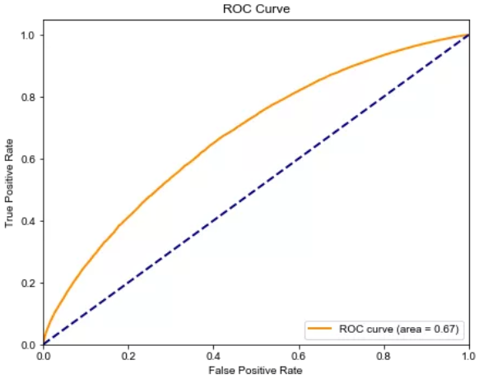
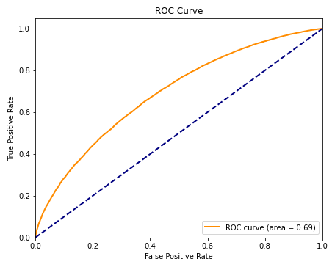
Logistic Regression
Before adding 2 new features
+--------+----------+-----------+--------+-------+ | auc | accuracy | precision | recall | f1 | +--------+----------+-----------+--------+-------+ | 0.669 | 0.736 | 0.750 | 0.945 | 0.835 | +--------+----------+-----------+--------+-------+
Before adding 2 new features, AUC = 0.67
After adding 2 new features
+--------+----------+-----------+--------+-------+ | auc | accuracy | precision | recall | f1 | +--------+----------+-----------+--------+-------+ | 0.690 | 0.737 | 0.751 | 0.953 | 0.840 | +--------+----------+-----------+--------+-------+
ROC Score increased 2%
Logistic Regression Score is 0.737
After adding 2 new features, AUC = 0.69

Slide 16
Contents
Part1 - Data Wrangling & Feature Selection
Part2 - Logistic Regression - Customer Churn Prediction Analysis
Part3 - Random Forest Forecasting - Customer Conversion Analysis
Part4 - RFM Modeling (K-Means) - Customer Value Analysis

Slide 17
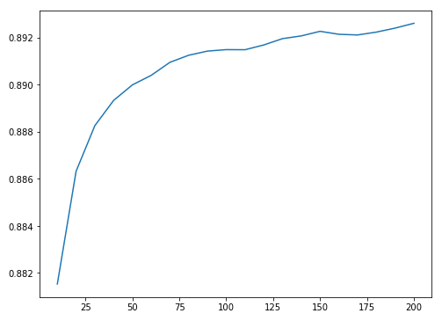
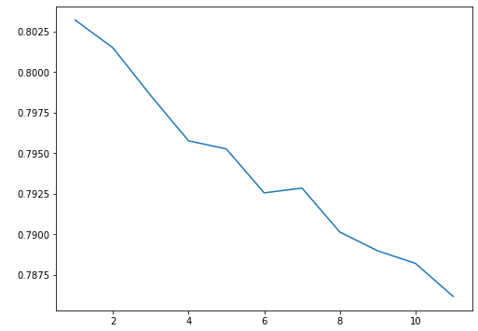
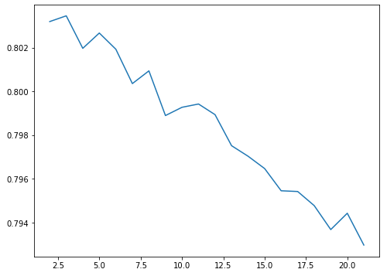
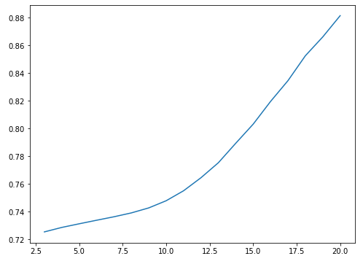
Random Forest Forecasting Model
Hyper Paremeter Tuning
Random Forest is an advanced ensemble technique in predicting customer churn
Use grid search to adjust parameters for below Optimum parameter portfolio -
N estimators=200
Min samples leaf=1
Min samples split=3
Maximum Depth = 20

Slide 18
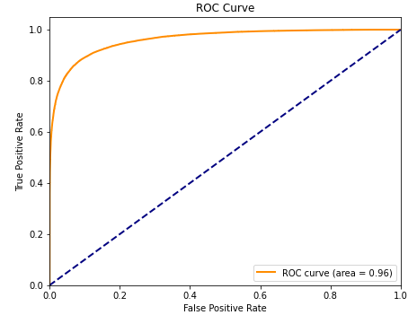
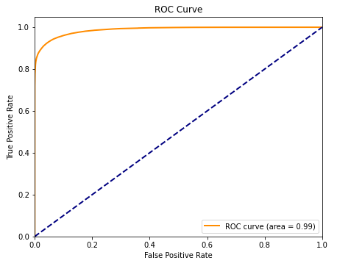
Random Forest Customer Churn Analysis
Best Parameters
n_estimators=200
max_depth=20
min_samples_leaf=1
min_samples_split=3
Before
Hyper parameter Tuning
Evaluation Results
Finally, the random forest classifier ensures that the ROC curve area reaches 0.97 without overfitting.
After
Hyper parameter Tuning

Slide 19
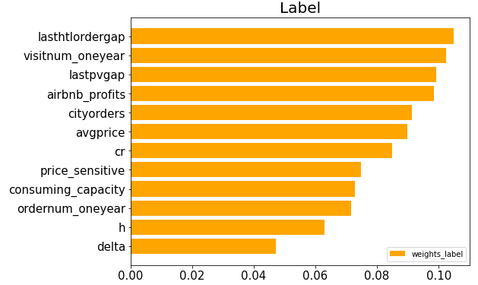
Random Forest Customer Churn Analysis
The Top 5 Importance Features
Lasthlordergap
Visitnum_oneyear
Lastpvgap
Airbnb_profits
Cityorders

Slide 20
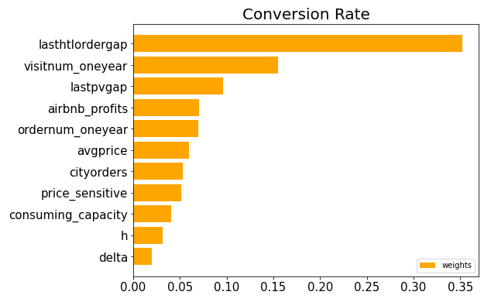
Random Forest Customer Conversion Analysis
The Top 5 Importance Features
Lasthlordergap
Visitnum_oneyear
Lastpvgap
Airbnb_profits
Ordernum_oneyear

Slide 21
Contents
Part1 - Data Wrangling & Feature Selection
Part2 - Random Forest Forecasting - Customer Conversion Analysis
Part3 - Logistic Regression - Customer Churn Prediction Analysis
Part4 - RFM Modeling (K-Means) - Customer Value Analysis

Slide 22
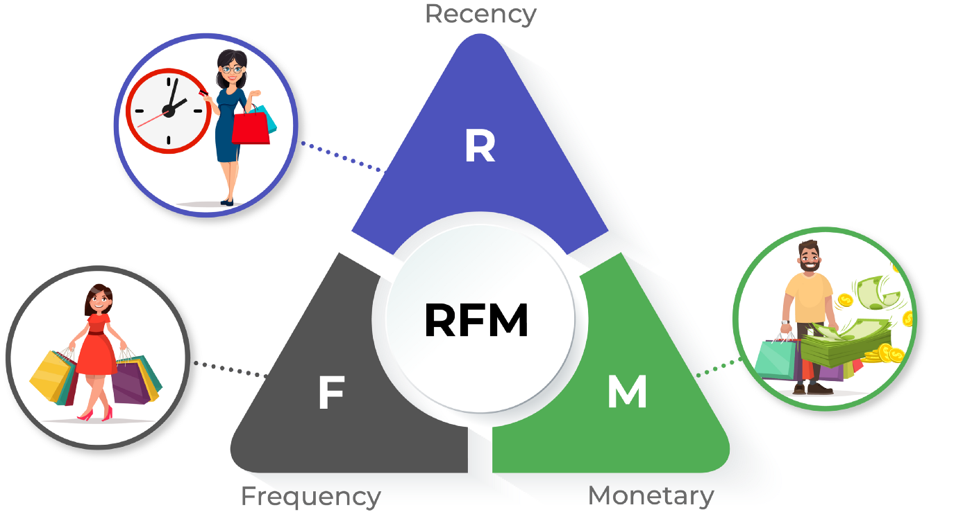
Introduction to RFM Model
A data-driven customer behavior segmentation technique
Recency, frequency, monetary value (RFM) is a marketing analysis tool used to identify a firm's best clients based on the nature of their spending habits.
An RFM analysis evaluates clients and customers by scoring them in three categories: how recently they've made a purchase, how often they buy, and the size of their purchases.
RFM analysis helps firms reasonably predict which customers are likely to purchase their products again, how much revenue comes from new (versus repeat) clients, and how to turn occasional buyers into habitual ones.
R(Recency)
Time difference between the customer's last transaction
The larger the R value, the longer the date the customer transaction occurred.
User stickiness, the smaller the better
F (Frequency)
The number of transactions by the customer in the most recent period of time
The larger the F value, the more frequent customer transactions
User loyalty, the bigger the better
M(Monetary)
The amount of transactions made by the customer in the most recent period of time.
The larger the M value, the higher the customer value.
User contribution, the bigger the better

Slide 23
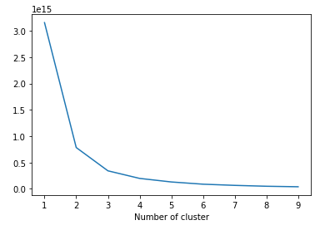
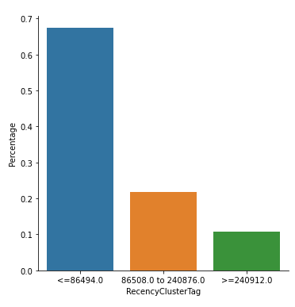
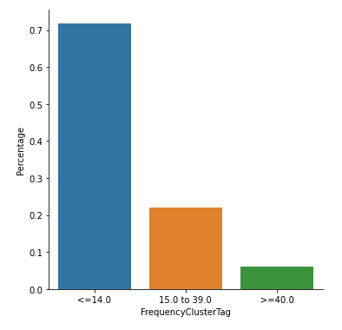
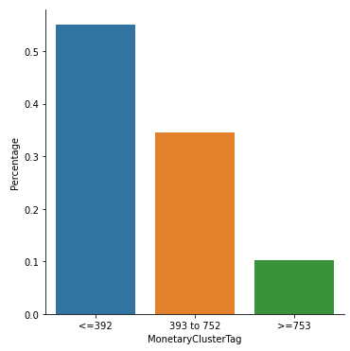
RFM K-means Clustering
Selected Features
RFM | R | F | M
Model | lasthtlordergap | ordernum_oneyear | avgprice
Unsupervised Learning
Using K means to determine RFM Clusters
In accordance with Elbow Method, the best clusters are 3.

Slide 24
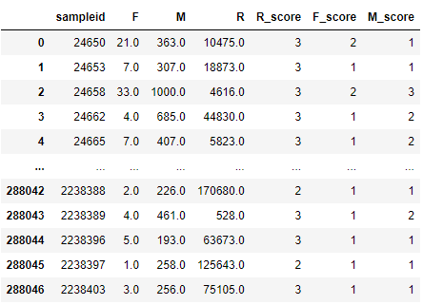

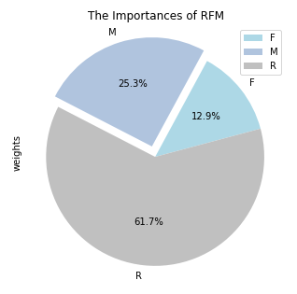
Random Forest Modeling
Label K-mean Cluster for RFM
Encode the cluster by 1-3 order
1 represents low score (worse)
2 represents median score (fair)
3 represents higher score (better)
For recency, the higher recency, the lower score
Overall Customer Value Score
0.6174*R score
+
0.1294*F score
+
0.2531*M score
Selected Feature Importance
Use RandomForest (Retention) to determine feature
importance for RFM, respectgively
RFM | R | F | M
Model | lasthtlordergap | ordernum_oneyear | avgprice
Weight | 0.6174 | 0.1294 | 0.2531

Slide 25
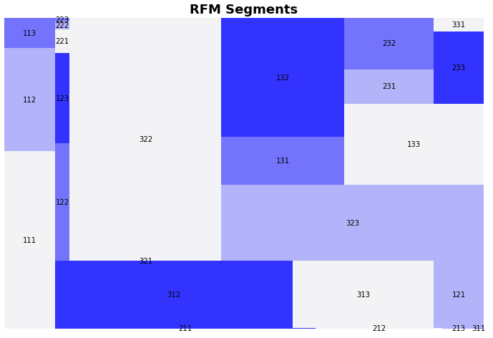
Introduction to RFM Model
A data-driven customer behavior segmentation technique
Create RFM Segments based on K-means clusters
Below are 5 largest groups from Airbnb App Users –
General speaking, the app still has lots of new users who haven’t engaged in the use of app for long time
Therefore, customer success team need to focus on improving user experience of new customer group
R | F | M | Segmentation
1 | 1 | 1 | churned customers
1 | 1 | 2 | churned customers
1 | 1 | 3 | Important customer for retention
1 | 2 | 1 | General customers for maintenance
1 | 2 | 2 | General customers for maintenance
1 | 2 | 3 | General customers for maintenance
1 | 3 | 1 | General customers for maintenance
1 | 3 | 2 | General customers for maintenance
1 | 3 | 3 | Important customer for recall
2 | 1 | 1 | General customers for maintenance
2 | 1 | 2 | General customers for maintenance
2 | 1 | 3 | General customers for maintenance
2 | 2 | 1 | General customers for maintenance
2 | 2 | 2 | General customers for maintenance
2 | 2 | 3 | Important customer for retention
2 | 3 | 1 | General customers for maintenance
2 | 3 | 2 | General customers for maintenance
2 | 3 | 3 | Important customer for recall
3 | 1 | 1 | New Customer
3 | 1 | 2 | General customers for maintenance
3 | 1 | 3 | Important customers for development
3 | 2 | 1 | General customers for maintenance
3 | 2 | 2 | New Customer
3 | 2 | 3 | Important customers for development
3 | 3 | 1 | Customers with potentials
3 | 3 | 2 | Customers with potentials
3 | 3 | 3 | Core Valuable Customers
RFM Group | Number
311 | 71,187
312 | 38,478
211 | 30,929
321 | 28,345
322 | 21,795

Slide 26
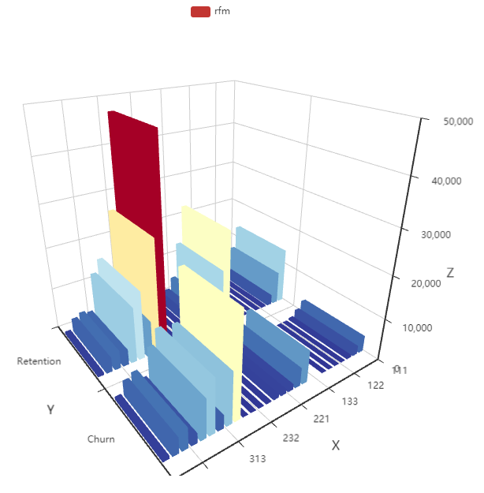
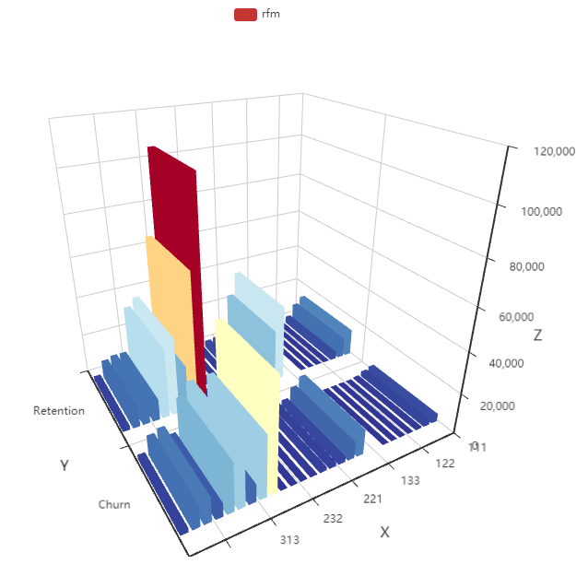
RFM Modeling
By Number of Users
Segment Customers based on RFM Groups
Height is measured by number of users
Customer Segments with best retention –
- 133, 233, 311
Customer Segments with lots of churn –
- 233, 311, 313
By Total Adjusted Values of Users
Segment Customers based on RFM Groups
Height is measured by total adjusted values of users
Customer Segments with most retention values –
- 133, 233, 313
Customer Segments with most of churn values –
- 133, 233, 313
By Number of Users
By Total Adjusted Values of Users

Slide 27
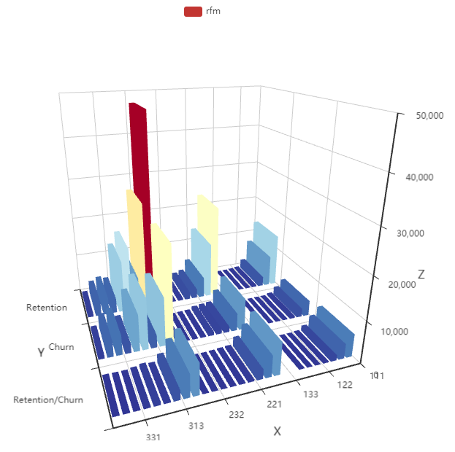
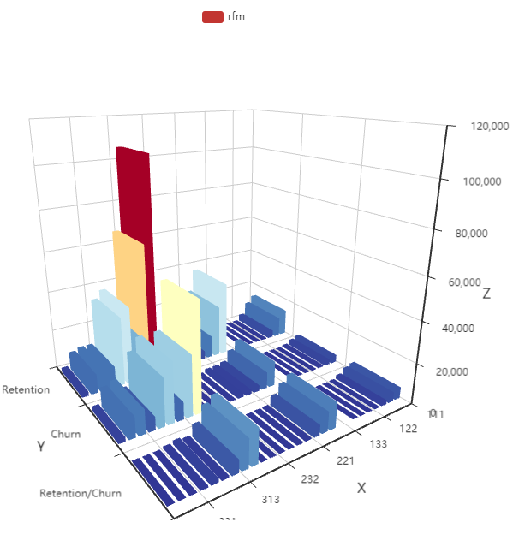
RFM Modeling
Adding new measurement
Retention/Churn represents the difference between number of user retention and churn quantify logarithm of the odds ratio for customer value score –
Formula: (number of retention – number of churn)*
log(sum(rfm score) of retention/sum(rfm score) of churn)
This new measurement can be used to quantify
the real value of each segments
Key Takeaways
Based on RFM Modeling & Analysis, below 3 segments of Airbnb App users take the majority of real market value
Airbnb need to focus on customer win of recalling customers and attracting new customers with Users having long recency or new customer most recently visit the app
By Number of Users
By Total Adjusted Values of Users
R | F | M | Segmentation
1 | 3 | 3 | Important customer for recall
2 | 3 | 3 | Important customer for recall
3 | 1 | 1 | New Customer

Slide 28
THANK YOU

